Slide 1
To Design and Implement A Smartphone Based Dynamic Fall Detection System
Presented By:
A S M Nazrul Islam
ID: 1204021
Supervised By:
Abu Hasnat Mohammad Ashfak Habib
Assistant Professor
Department of CSE, CUET

Slide 2



Introduction
A fall is defined as an event which results in a person coming to rest in advertently on the ground or floor or other lower level. [Source: WHO]
Second leading cause of death
6, 46,000 individuals [1] die globally from falls
Over 17 million DALYs (disability-adjusted life years)

Slide 3

Introduction (Cont.)
Fall detection of a person refers to the detection of human fall in terms of physical parameters of him/her.

Slide 4
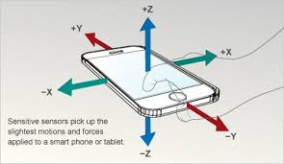
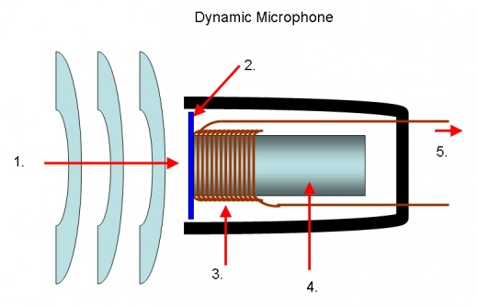
Introduction (Cont.)
System deals with the physical parameters
A computational approach is established
to detect fall and smart feedback
Considered acceleration and sound level as physical parameters

Slide 5
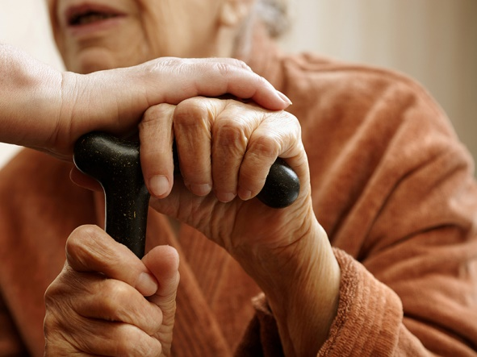
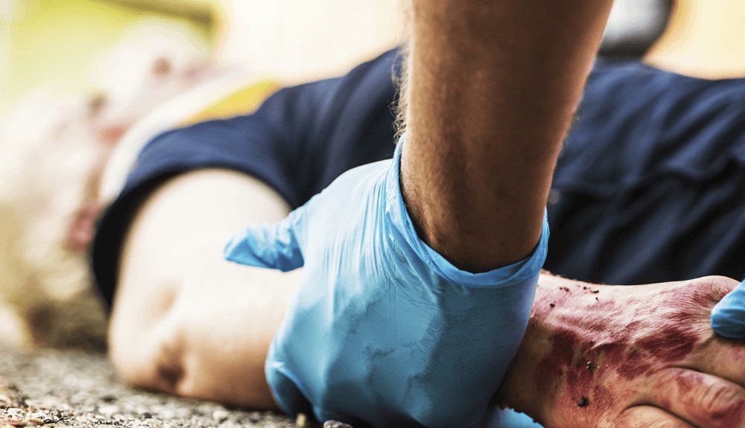
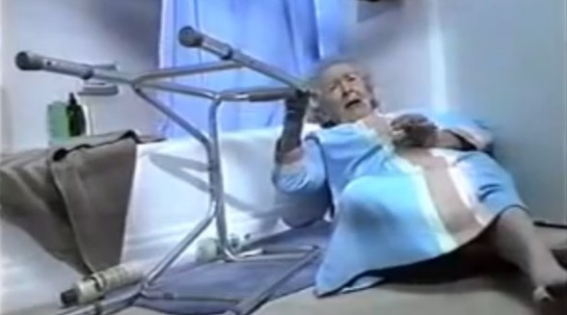
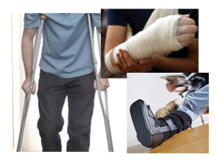
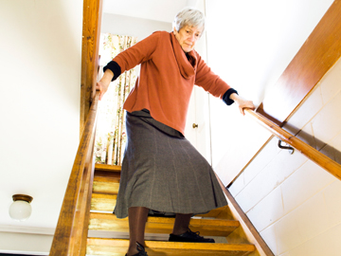
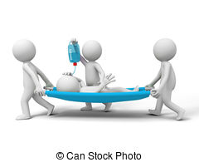
Motivation
Fatal injury
Psychological affects
Unexpected death

Slide 6
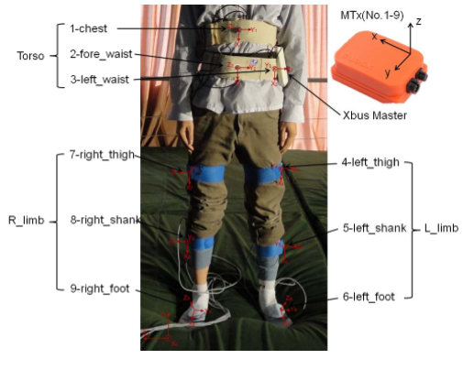
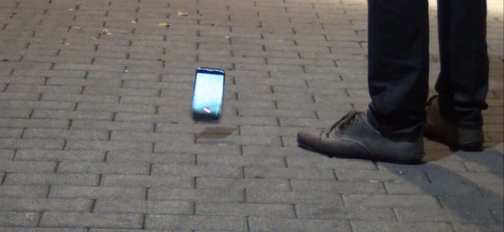
Motivation (Cont.)
Not user friendly
Can’t distinguish between free fall and human fall

Slide 7
Previous work
The prevailing fall detection systems can be classified into three categories based on their fall detection technique
Accelerometer-based fall detection
Database-based fall detection
Image processing-based fall detection

Slide 8
Previous work (Cont.)
Accelerometer-based fall detection systems
[Nyan et al. & Kangas et al.] :
Detects fall using accelerometer
Uses predefined fixed threshold
Applicable for a predefined fixed place of human body condition
Much more prone to false negativity due to depending only in accelerometer’s value

Slide 9
Previous work (Cont.)
Database Based Fall Detection System [Ganti et al. , Karantonis et al.] :
Uses database to store the sensed user behavioral data
System’s performance fully depends on the database
May become inefficient if the database is compromised or undergo unauthorized modification

Slide 10
Previous work (Cont.)
Image Processing Based Fall Detection System
[Fu et al., Sixsmith et al., Miaou et al., Jansen et al.] :
Detects fall by analyzing the falling images.
Have limitations on pervasive detection
The detection area is limited by the surrounding environment.

Slide 11
Previous work (Cont.)
Smartphone Based Fall Detection System
[In Symbian OS on Nokia phones, Fade, Emergency Fall Detector]
Detects fall using smartphone’s built-in sensor
The smartphone’s position is kept fixed to use a fixed threshold
Can’t differentiate between free fall and human fall
Have an unbalanced co-relation between false positivity and false negativity

Slide 12
Contributions
To design and implement a novel smartphone-based fall detection technique that uses multiple numbers of inbuilt smartphone sensors.
To make the technique dynamic so that it can automatically detect the position of the smartphone and select the appropriate threshold values accordingly.
To make the technique false alarm exempt by fusing multiple sensor’s value, so that it can avert the limitations of the previous works.
To make the technique robust and efficient by placing instant communication right after the occurrence of fall. Hence, resulting in restoring life.

Slide 13

System Architecture/Methodology
Monitoring Phase
Fall Detection Phase
Post Fall Detection Phase

Slide 14
System Architecture/Methodology
Monitoring Phase
Monitoring Phase
Data Collection Module
Training Module
Get User Information
Working as Daemon
Set Threshold Value

Slide 15
System Architecture/Methodology
Fall Detection Phase
Data Analysis Module
Sensor Fusion Module
Monitoring Phase
Detecting Phone Position
Checking Fall Module
Accelerometer Sensor
Fall Detection Phase
Microphone Sensor
Set Threshold Value
Accelerometer Sensor
Orientation Sensor
Microphone Sensor
Orientation Sensor

Slide 16
System Architecture/Methodology
Monitoring Phase
Post Fall Detection Phase
Fall Detection Phase
Alarm Module
Post Fall Detection Phase
Communication Module
Monitoring Phase

Slide 17
Continued
Accelerometer Sensor
|A_{T}| = √ (|A_{X}|² +|A_{Y}|² + |A_{Z}|²)………(1)
Reaction
Gravity

Slide 18
Continued
Accelerometer Sensor
|A_{T}| = √ (|A_{X}|² +|A_{Y}|² + |A_{Z}|²)………(1)
Reaction
Gravity

Slide 19
Continued
Accelerometer Sensor
|A_{T}| = √ (|A_{X}|² +|A_{Y}|² + |A_{Z}|²)………(1)
Reaction
Gravity

Slide 20
Continued
Free fall
Human fall

Slide 21
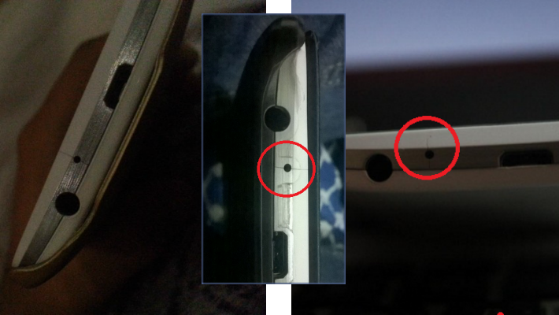
Continued
Microphone Sensor
$pressure= amplitude/51805.5336$ ….…….….. (2)
Maximum sound level = 90 dB = 0.6325 Pa.
Minimum sound level = 0 dB = 0.00002 Pa.
Maximum magnitude that can be saved in the array is 32,767
Minimum magnitude that can be saved in the array is 0
$dB=(20∗log10\left(\frac{pressure}{REFERENCE }\right))$ ……………...… (3)

Slide 22
Continued
Talking Sound
Falling Sound

Slide 23
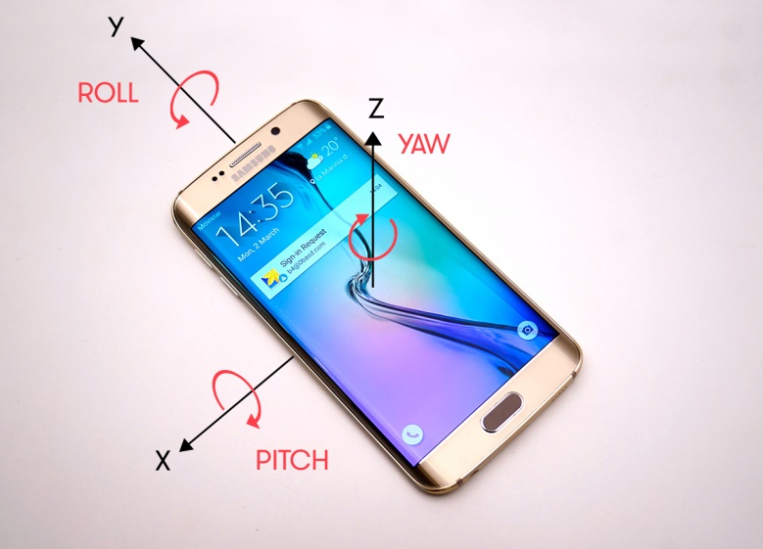
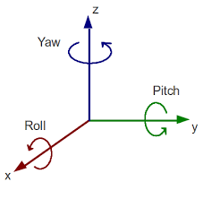
Continued
Orientation Sensor
|A_{V}| = |A_{X} sin θ_{Z} + A_{Y} sin θ_{Y} + A_{Z} cos θ_{Y} cos θ_{Z} |…………… (4)

Slide 24
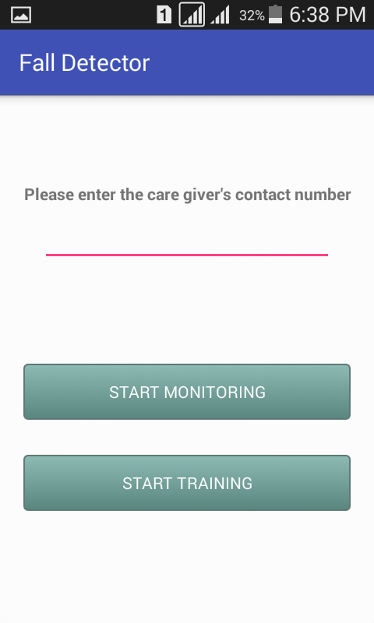
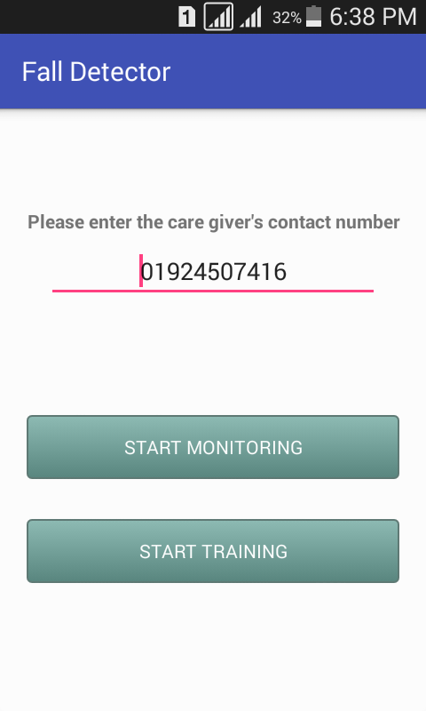
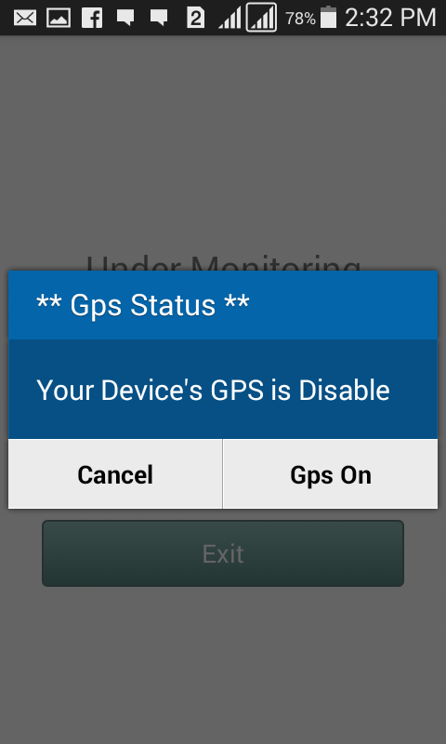
Implementation

Slide 25
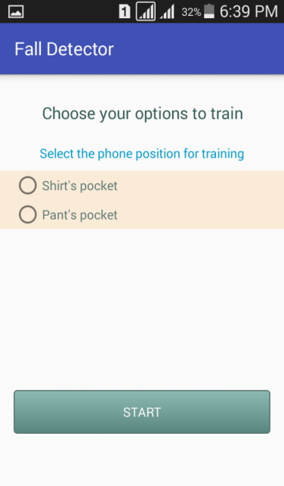
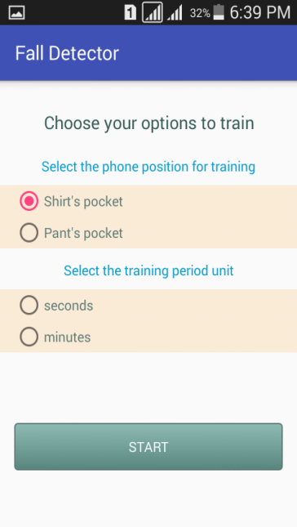
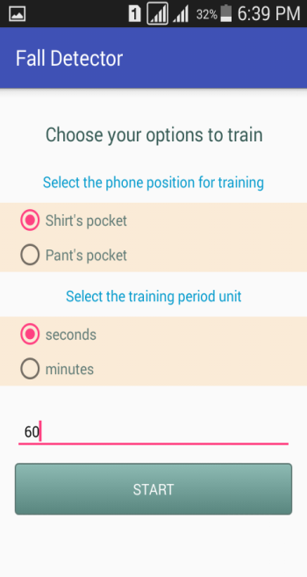
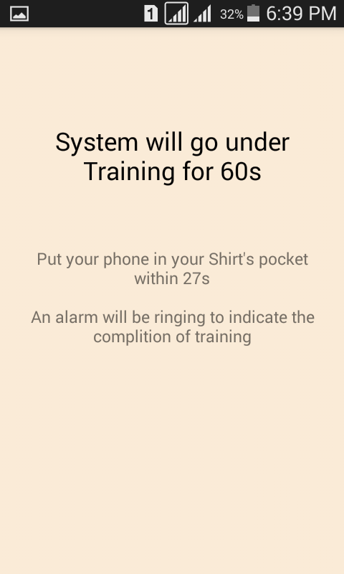
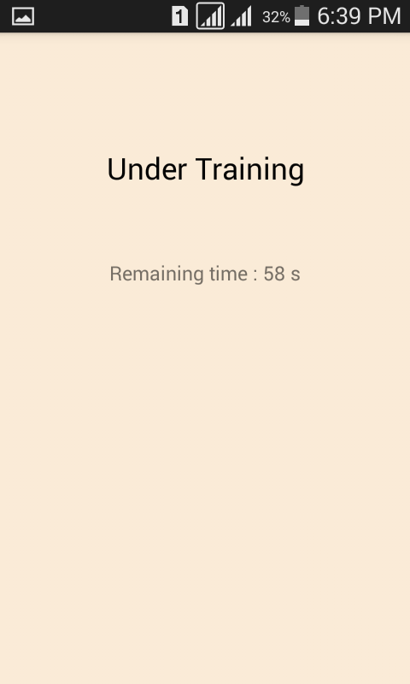
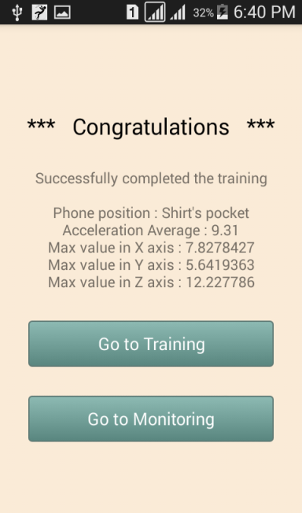
Continued

Slide 26
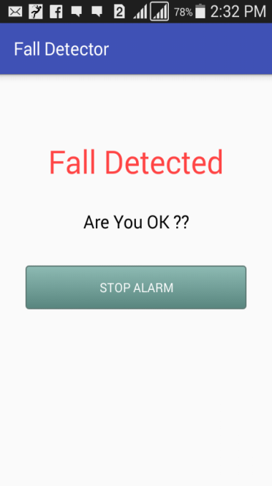
Continued

Slide 27
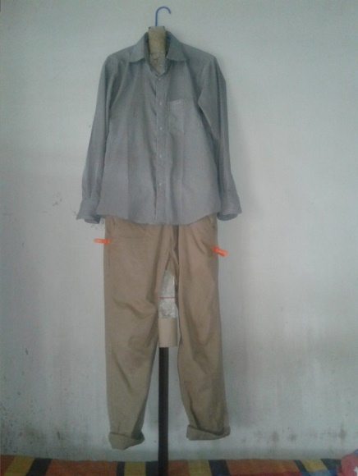
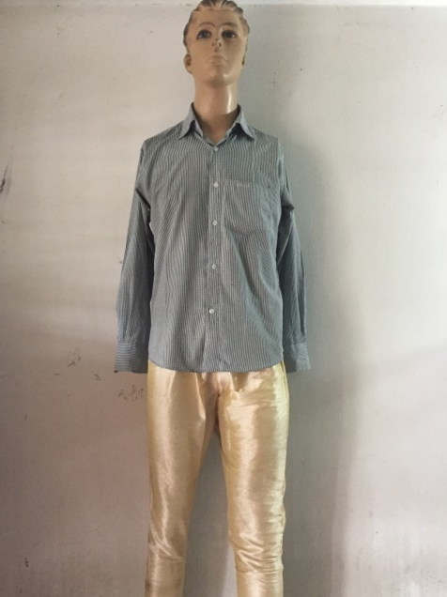
Experiment subjects
Used Mannequin
Used Dummy

Slide 28
Experiment Results
here, there was a video, how my system works. But due to size complexity this slide is discarded.

Slide 29
Experiment Results

Slide 30
Performance Analysis
Obtained data from participants for Smart Phone position detection
 | Trial time (in minute) | Shirt’s pocket |  |  | Pants pocket
 |  | X axis value range (in ms⁻²) | Y Axis value range (in ms⁻²) | Z axis value range (in ms⁻²) | X axis value range (in ms⁻²) | Y Axis value range (in ms⁻²) | Z axis value range (in ms⁻²)
Participant 1 | 10 | 4-6 | 5-7 | 4-6 | 20-27 | 12-15 | 13-21
Participant 2 | 10 | 4-7 | 6-8 | 3-5 | 20-28 | 13-18 | 14-22
Participant 3 | 10 | 4-6 | 6-9 | 3-6 | 20-26 | 13-17 | 13-23
Participant 4 | 10 | 4-8 | 5-9 | 4-8 | 20-27 | 13-17 | 15-25
Participant 5 | 10 | 3-15 | 4-16 | 2-14 | 2-16 | 1-19 | 3-21
Participant 6 | 10 | 4-11 | 5-9 | 5-14 | 18-29 | 12-23 | 14-29
Participant 7 | 10 | 4-9 | 6-10 | 7-13 | 16-34 | 18-27 | 18-33
Participant 8 | 10 | 2-4 | 6-8 | 3-9 | 18-27 | 15-17 | 26-32
Participant 9 | 10 | 3-5 | 6-9 | 3-5 | 14-23 | 15-19 | 29-33
Participant 10 | 10 | 2-5 | 6-9 | 3-7 | 17-31 | 13-22 | 17-32

Slide 31
Continued
Sensor data for first human-shaped dummy
For Smartphone Placed in Shirt’s Pocket
Test No | Triggered Accelerometer value range(ms⁻²) | Triggered Microphone value (dB)
01 | 9.8-4.24-1.57-0.76-8.8 | 80.8583 - 49.1261
02 | 9.8-5.5-1.38-23.6-8.8 | 82.6055 - 47.6501
03 | 10.2-3.76-4.78-8.9 | 80.1791 - 47.9251
04 | 9.5-5.42-1.15-13.95-8.8 | 86.2160 - 51.4892
05 | 9.8-3.3-21.76-8.8 | 85.3391 - 53.3218
06 | 11-4.3-20.42-7.3-3.94-1.65-10.26-8.8 | 85.1860 - 48.7985
07 | 10.5-5.37-0.37-3.1-8.8 | 81.1150 - 46.9491
08 | 9.2-5.5-0.83-23.26-8.8 | 85.9021 - 49.9327
09 | 9.5-5.6-2.9-10.3 | 84.7467 - 50.5228
10 | 10.6-1.81-2.87-6.72-14.1-10.3 | 81.6661 - 45.6302

Slide 32
Continued
Sensor data for first human-shaped dummy
For Smartphone Placed in Pants Pocket
Test No | Triggered Accelerometer value range(ms⁻²) | Triggered Microphone value (dB)
01 | 10-6.8-4.3-14.15-8.8 | 80.3023 - 49.6289
02 | 9.4-3.9-5.5-8.9 | 79.7551 - 47.7116
03 | 10-4.3-30.68-8.8 | 81.4088 - 49.9619
04 | 9.8-5.8-4.8-11.92-8.8 | 80.3526 - 48.0912
05 | 10.2-6.4-2.5-9.3-8.8 | 79.1303 - 42.0774
06 | 10-5.2-21.38-3.2-9-8.9 | 79.4037 - 48.0254
07 | 9.9-5.2-7.1-8.8 | 80.4588 - 38.7683
08 | 8.8-6.8-5.4-1.7-8.8 | 79.0109 - 26.6437
09 | 13-4.1-9-7-8.8 | 72.3602 - 31.3955
10 | 11.5-5.5-7.5-8.8 | 81.2497 - 49.1070

Slide 33
Continued
Sensor data for second human-shaped dummy
For Smartphone Placed in Shirt’s Pocket
Test No | Triggered Accelerometer value range(ms⁻²) | Triggered Microphone value (dB)
01 | 9.8-7.4-4.3-1.4-2-8.8 | 82.7626 - 49.4779
02 | 9.9-7.6-4-1.2-11.8-8.9 | 81.6343 - 48.2639
03 | 10-7-4-6.9-11.3-10.3 | 84.3358 - 49.4224
04 | 9.6-7.7-4.5-1.74-1.68-9.4-8.8 | 85.6883 - 46.07905
05 | 9.8-5.7-1.6-6.7-4.6-8.8 | 78.1974 - 46.1443
06 | 19.9-5.6-2.6-6.8-10.2 | 79.3936 - 46.7854
07 | 11.4-9.3-25-3.5-5.6-10.2 | 79.5362 - 46.7551
08 | 11.3-5.4-2.2-6.2-10.4-8.8 | 79.0868 - 48.1032
09 | 12-7.5-2.6-3.3-33.9-9.7-8.8 | 82.7787 - 48.3302
10 | 10-2.3-5.2-21-8.8 | 72.8169 - 37.1957

Slide 34
Continued
Sensor data for second human-shaped dummy
For Smartphone Placed in Pants Pocket
Test No | Triggered Accelerometer value range(ms⁻²) | Triggered Microphone value (dB)
01 | 10.2-6-5.41-8.8 | -
02 | 10-7.9-5.6-9.2-10.3 | 78.0054 - 46.9752
03 | 10-6.2-4.9-9-8.8 | 76.6901 - 45.1428
04 | 10-6.9-4.7-32.8-8.8 | 77.8208 - 47.2657
05 | 10-7.1-4.8-28-8.9 | 79.3187 - 48.5401
06 | 11-8.2-1.6-2.1-8.8 | 78.5249 - 47.4757
07 | 10.7-6.7-17.2-6.6-10.3 | 74.8216 - 43.4051
08 | 11-7.7-5.8-5.7-1.6-8.8 | 80.7450 - 50.3683
09 | 11-8.8-14.5-7.5-4.88-7.6-18.8-8.8 | 76.9961 - 45.4232
10 | 11.2-1.7-6.3-33.9-8.8 | 78.2517 - 48.0408

Slide 35
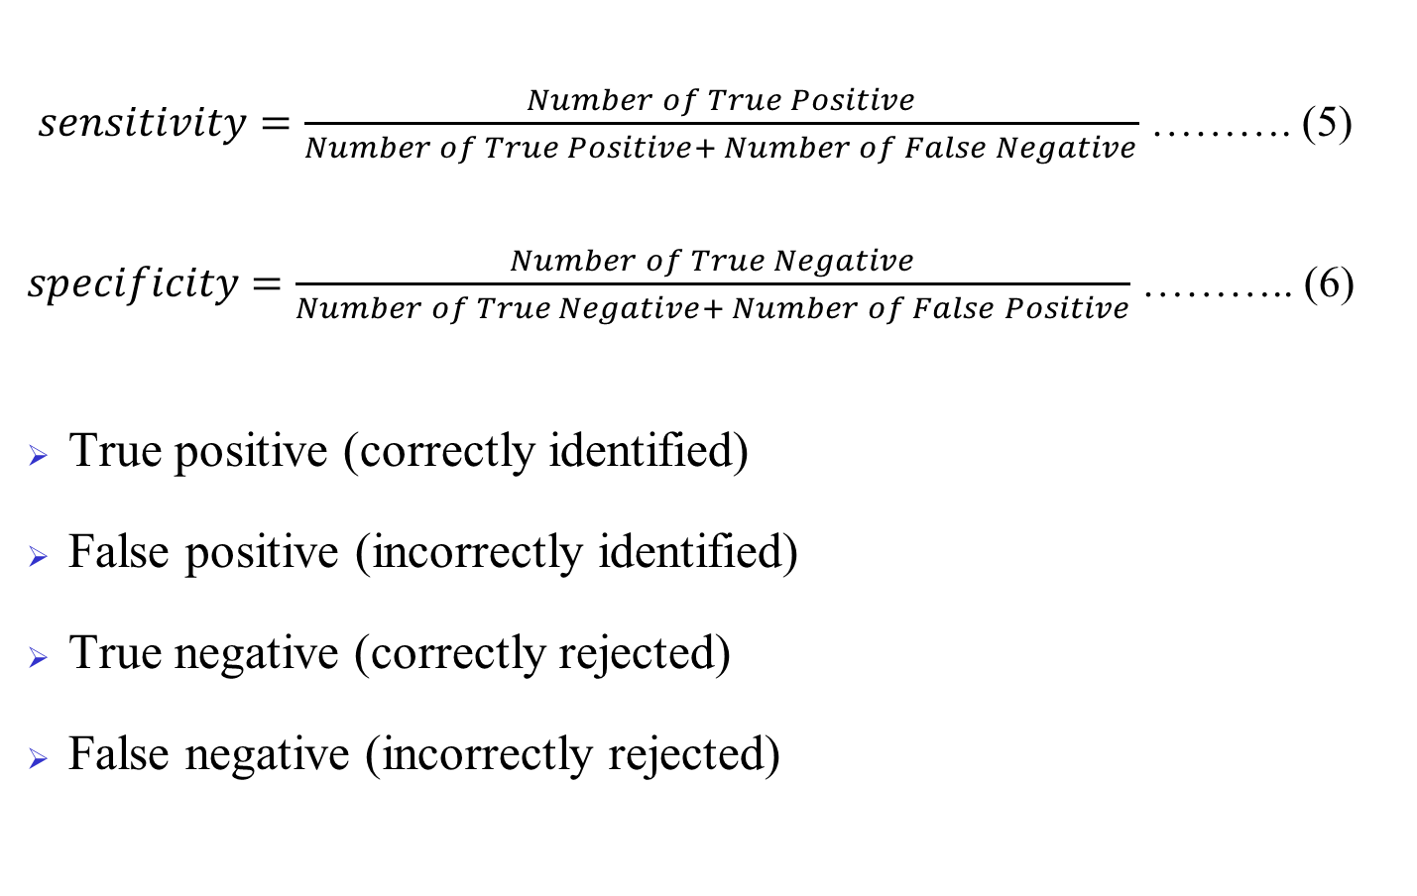
Evolution of the system
$sensitivity=\frac{Number of True Positive}{Number of True Positive+ Number of False Negative}$ ………. (5)
$specificity=\frac{Number of True Negative}{Number of True Negative+ Number of False Positive}$ ……….. (6)
True positive (correctly identified)
False positive (incorrectly identified)
True negative (correctly rejected)
False negative (incorrectly rejected)

Slide 36
Continued
Experimental Results of the System
 | Smartphone position | Number of trials | Number of fall detected | Number of false positive | Accuracy (%) | Error rate (%)
Dummy no 01 | Shirt’s pocket | 24 | 20 | 04 | 83.33% | 16.66%
 | Pants pocket | 29 | 28 | 01 | 96.55% | 3.44%
Dummy no 02 | Shirt’s pocket | 10 | 19 | 01 | 90% | 10%
 | Pants pocket | 10 | 18 | 02 | 80% | 20%

Slide 37
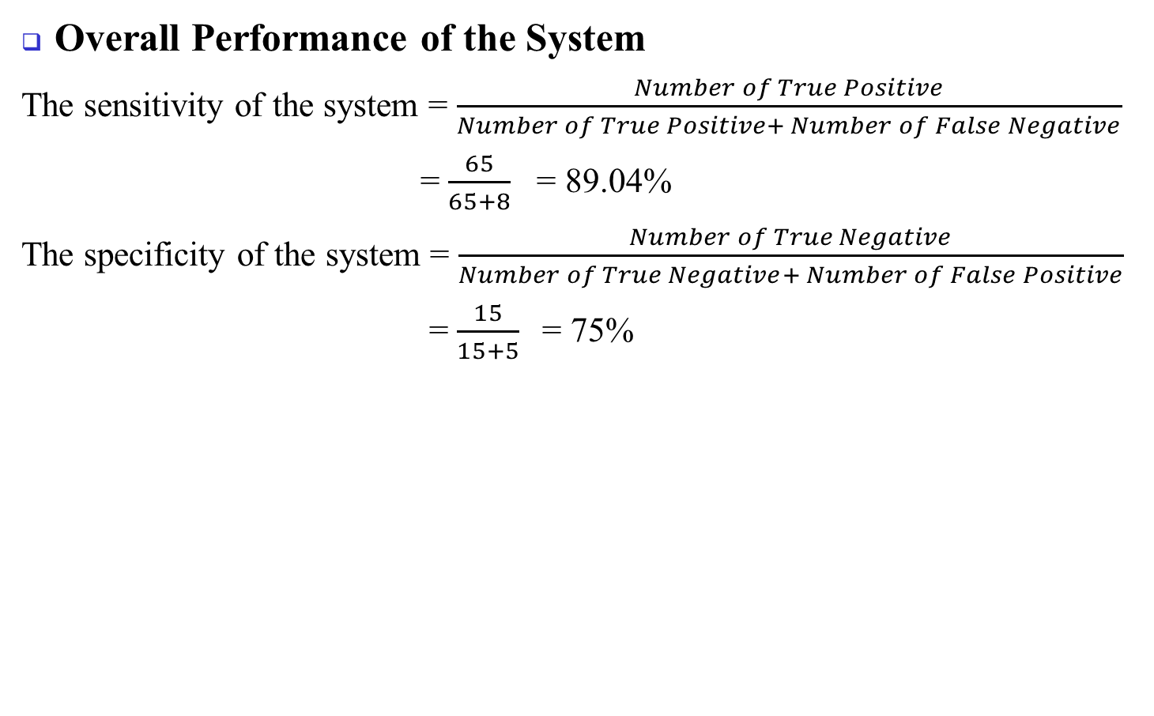
Continued
Overall Performance of the System
The sensitivity of the system = $\frac{Number of True Positive}{Number of True Positive+ Number of False Negative}$
= $\frac{65}{65+8}$ = 89.04%
The specificity of the system = $\frac{Number of True Negative}{Number of True Negative+ Number of False Positive}$
= $\frac{15}{15+5}$= 75%
 | Number of trials | Estimated result | Deviation | Sensitivity | Specificity
Free fall | 20 | 15 | 5 | 89.04% | 75%
Mimic of human fall | 73 | 65 | 8

Slide 38
Continued
Comparison with existing systems
 | Fade | Emergency fall detector | PerFallD | Fall Detector (implemented system)
Multiple sensor | × | × | ✓ | ✓
Accelerometer used to detect fall | ✓ | ✓ | ✓ | ✓
Microphone used to detect fall | × | × | × | ✓
Continuous monitoring | × | ✓ | × | ✓
False fall tolerant | × | × | ✓ | ✓
Works on locked state | × | ✓ | - | ✓
Sensitivity | 100% | 100% | - | 89.04%
Specificity | 0% | 0% | - | 75%

Slide 39
Future Work
Setting thresholds observing real human fall
Distinguishing human fall from free fall more accurately
Considering more fall detector parameters like height change, location change
Working with more in-built sensors
Working with different types of fall for any position of smartphone

Slide 40
Conclusion
The system can differentiate human fall from free fall
Uses multiple smartphone’s inbuilt sensors to detect fall
Can detect smartphone position automatically and set threshold accordingly
After detecting fall place instant communication to reduce post-fall affects

Slide 41
References
[1] World Health Organization (WHO)’s official site [Online], Available at http://www.who.int/mediacentre/factsheets/fs344/en/ Accessed 8 November 2017.
[2] Alexander BH, Rivara FP, Wolf ME, “The cost and frequency of hospitalization for fall–related injuries in older adults”, in proc. American Journal of Public Health, 1992; 82(7): pp.1020–3
[3] Sterling DA, O'Connor JA, Bonadies J. “Geriatric falls: injury severity is high and disproportionate to mechanism”, in proc. Journal of Trauma–Injury, Infection and Critical Care, 2001; vol 50(1): pp.116–9.
[4] Hayes WC, Myers ER, Morris JN, Gerhart TN, Yett HS, Lipsitz LA. “Impact near the hip dominates fracture risk in elderly nursing home residents who fall”, in proc. Calcified Tissue International, 1993;vol 52: pp.192-198.
[5] Jager TE, Weiss HB, Coben JH, Pepe PE. “Traumatic brain injuries evaluated in U.S. emergency departments, 1992–1994”, in proc. Academic Emergency Medicine 2000&359; vol 7(2): pp.134–40.
[6] World report on child injury prevention, Geneva: World Health Organization (WHO), ISBN 978 92 4 156357 4, 2008.
[7] Bangladesh Health and Injury Survey Report on Children, Directorate General of Health Services, Ministry of Health and Family Welfare, Government of the People's Republic of Bangladesh, Published: January 2005, ISBN 92-806-3855-6.

Slide 42
References(cont.)
[8] Centers for Disease Control and Prevention, National Center for Injury Prevention and Control[Online], Available at https://www.cdc.gov/homeandrecreationalsafety/falls/adult falls.html Accessed 15 November, 2017.
[9] Burns EB, Stevens JA, Lee RL. “The direct costs of fatal and non-fatal falls among older adults—United States”, in proc. Journal of Safety Research, 2016:58.
[10] Vellas BJ, Wayne SJ, Romero LJ, Baumgartner RN, Garry PJ. “Fear of falling and restriction of mobility in elderly fallers”, Age and Ageing 1997; vol 26: pp.189–193.
[11] Nyan MN, Tay FE, Manimaran M, Seah KH. “Garmentbased detection of falls and activities of daily living using 3-axis MEMS accelerometer”, in proc. Journal of Physics Conference Series , 2006,vol 34: pp.1059–1067
[12] Kangas M, Konttila A, Lindgren P, Winblad I, Jamsa T. “Comparison of low-complexity fall detection algorithms for body attached accelerometers”,in proc. Gait Posture , 2008,vol 28(2): pp.285–291
[13] Brown G. “An accelerometer based fall detector: development, experimentation, and analysis”, SUPERB internship report, University of California, Berkeley, 2005.

Slide 43
References(cont.)
[14] Hwang JY, Kang JM, Jang YW, Kim HC. “Development of novel algorithm and real-time monitoring ambulatory system using Bluetooth module for fall detection in the elderly.”, In: Proceedings of 26th annual international conference of the engineering in medicine and biology society, IEEE-EMBS 2004.
[15] Pannurat N, Thiemjarus S, Nantajeewarawat E. “Automatic Fall Monitoring: A Review. Sensors”, 2014, 14, pp. 12900–12936.
[16] Yuan B, Herbert J. “Non-Intrusive Movement Detection in Cara Pervasive Healthcare Application”, In Proceedings of the 2011 International Conference on Wireless Networks, (WORLDCOMP), Las Vegas, NV, USA, 18–21 July 2011; pp. 360–366.
[17] Honglun H, Meimei H, Minghui W. “Sensor-Based Wireless Wearable Systems for Healthcare and Falls Monitoring”, Int. J. Smart Sens. Intell. Syst. 2013, 6, pp.2200–2216.
[18] Shuo C. “Fall Detection System Using Arduino Fio”. In Proceedings of the IRC Conference on Science, Engineering and Technology, Singapore, 13 May 2015.
[19] Available at http://www.brickhousealert.com/personal-emergency-medicalalarm.htm [Online] Accessed 8 January, 2017.
[20] Available at https://www.medicalguardian.com/product/home-guardian [Online] Accessed 15 November, 2017.

Slide 44
References(cont.)
[21] Ganti RK, Jayachandran P, Abdelzaher TF, Stankovic JA, “SATIRE: a software architecture for smart AtTIRE”, In: Proceedings of the 4th international conference on mobile systems, applications and services, MobiSys, 2006.
[22] Karantonis DM, Narayanan MR, Mathie M, Lovell NH, Celler BG, “Implementation of a real-time human movement classiﬁer using a triaxial accelerometer for ambulatory monitoring”, in proc. IEEE Trans Inf Technol Biomed, 2006, 10(1): pp.156–167
[23] Fu Z, Culurciello E, Lichtsteiner P, Delbruck T, “Fall detection using an address-event temporal contrast vision sensor”:, In: Proceedings of IEEE international symposium on circuits and systems, ISCAS, 2008.
[24] Sixsmith A, Johnson N., “A smart sensor to detect the falls of the elderly”, in proc. Pervasive Comput, 2004, vol 3(2): pp.42–47.
[25] Miaou S, Sung P, Huang C., “A customized human fall detection system using omni-camera images and personal information”, In: Proceedings of 1st distributed diagnosis and home healthcare conference, 2006.
[26] Jansen B, Deklerck R., “Context aware inactivity recognition for visual fall detection”, In: Proceedings of pervasive health conference and workshops, 2006.

Slide 45
References(cont.)
[27] Zhao Z, Chen Y, Wang S, Chen Z. “FallAlarm: Smart Phone Based Fall Detecting and Positioning System”, In Proceedings of the 9th International Conference on Mobile Web Information Systems (MobiWIS), Niagara Falls, ON, Canada, 27–29 August 2012; pp. 617–624.
[28] Laguna MA, Finat J. “Remote Monitoring and Fall Detection: Multiplatform Java Based Mobile Applications”, In Proceedings of the III International Workshop of Ambient Assisted (Living IWAAL 2011), Torremolinos-Málaga, Spain, 8–10 June 2011; pp. 1–8.
[29] Yu X. “Approaches and Principles of Fall Detection for Elderly and Patient”, In Proceedings of the 10th International Conference on E-Health Networking, Applications and Services (HealthCom 2008), Singapore, 7–9 July 2008; pp. 42–47.
[30] Noury N, Fleury A, Rumeau P, Bourke A, Laighin G, Rialle V, Lundy J. “Fall Detection-Principles and Methods”, In Proceedings of the 29th Annual International Conference of the IEEE Engineering in Medicine and Biology Society (EMBS 2007), Lyon, France, 22–26 August 2007; pp. 1663–1666.
[31] Hegde R, Sudarshan B, Kumar S, Hariprasad S, Satyanarayana B. “Technical Advances in Fall Detection System—A Review. Int. J. Comput. Sci. Mob. Comput. 2013, 2, 152–160.
[32] Noury N, Rumeau P, Bourke A, ÓLaighin G, Lundy J. “A Proposal for the Classification and Evaluation of Fall Detectors”, IRBM 2008, 29, pp.340–349.

Slide 46
References(cont.)
[33] Hijaz F, Afzal N, Ahmad T, Hasan O. “Survey of Fall Detection and Daily Activity Monitoring Techniques”, In Proceedings of the 2010 International Conference on Information and Emerging Technologies (ICIET), Pakistan, 14–16 June 2010; pp. 1–6.
[34] Habib MA, Mohktar MS, Kamaruzzaman SB, Lim KS, Pin TM, Ibrahim F. “Smartphone-Based Solutions for Fall Detection and Prevention: Challenges and Open Issues’, Sensors 2014, 14, pp.7181–7208.
[35] Terroso M, Rosa N, Marques AT, Simons R. “Physical consequences of falls in the elderly: a literature review from 1995 to 2010”, Eur Rev Aging Phys Act (2014)
[36] Available at http://www.healthinaging.org/aging-and-health-a-to-z/topic:falls/info :causes-and-symptoms/ [online] Accessed 15 November, 2017.
[37] Hormann W. Kommunikationstechnologie im Dienst amMenchen. In HAUSNOTRUFSYSTEME Kommunikationstechnologie imDienst am Menchen; Heilscher W, Ed, Wirtschaftsverlag NW: Bremerhaven, Germany, 1980. (In Geman)
[38] Hansen TR, Ekund JM, Sprinkle J, Bajcsy R, Sastry S. “Using smart sensors and a camera phone to detect and verify the fall of elderly persons”, In Proceedings of the European Medicine, Biology and Engineering Conference, Prague, Czech Republic, 20-25 November 2005.

Slide 47
Thank You

